Slide 1

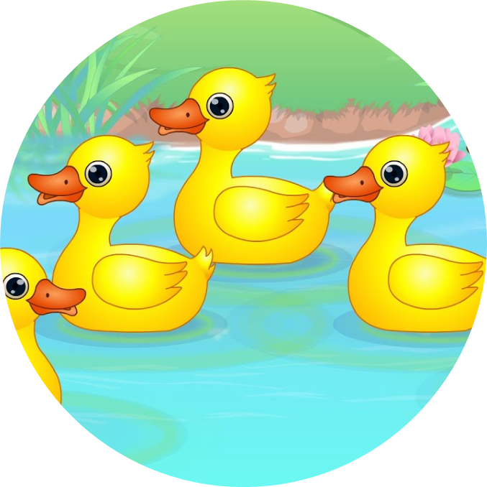
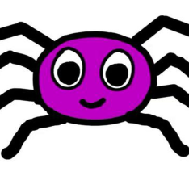
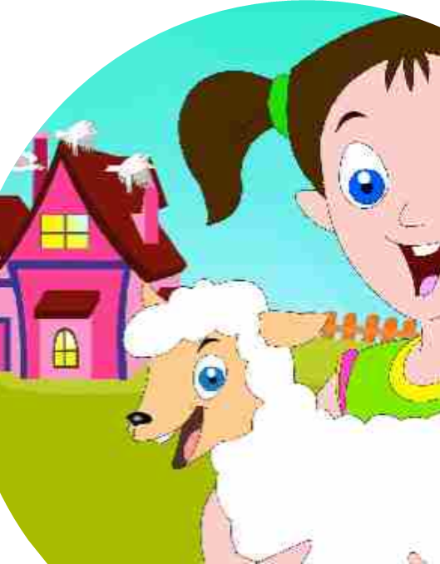
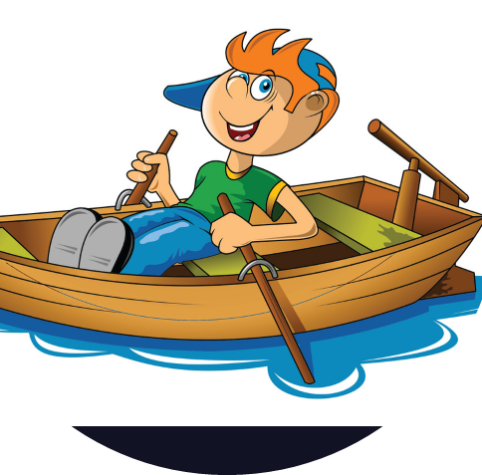
Songs for EYFS and Year 1
Coventry Music
Collated by Claire Tyler MEO

Slide 2
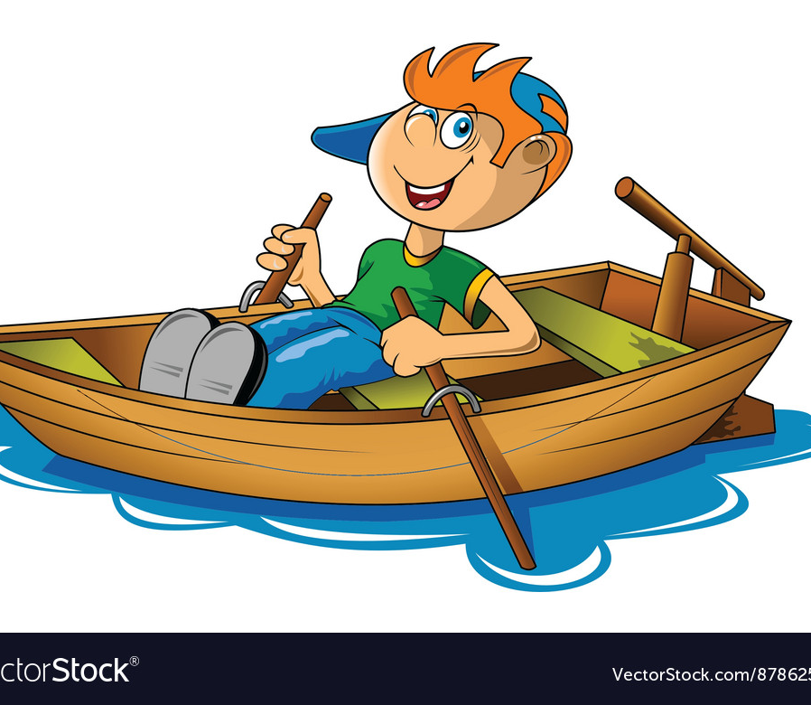
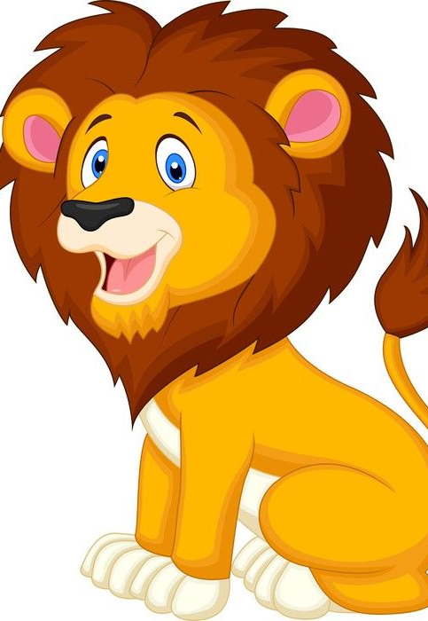
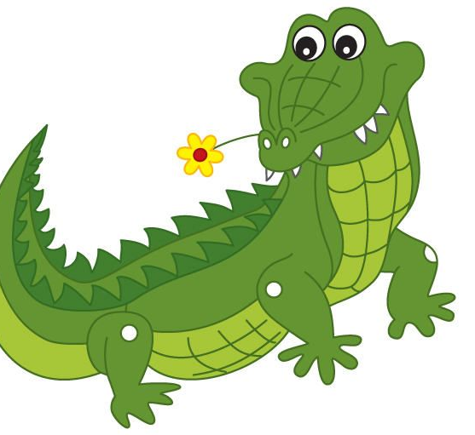
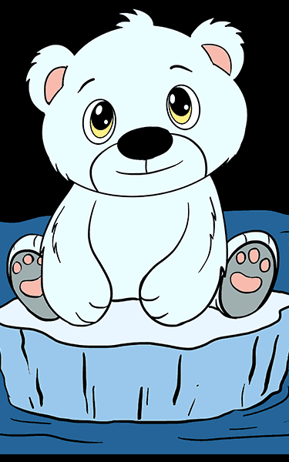
Row Row Row
Row row row your boat, gently down the stream
Merrily, merrily, merrily, life is but a dream.
Row row row your boat gently down the stream
If you see a crocodile, don’t forget to scream!
Row row row your boat gently down the river
If you see a polar bear, don’t forget to shiver!
Row row row your boat gently to the shore
If you see a lion there, don’t forget to roar!

Slide 3
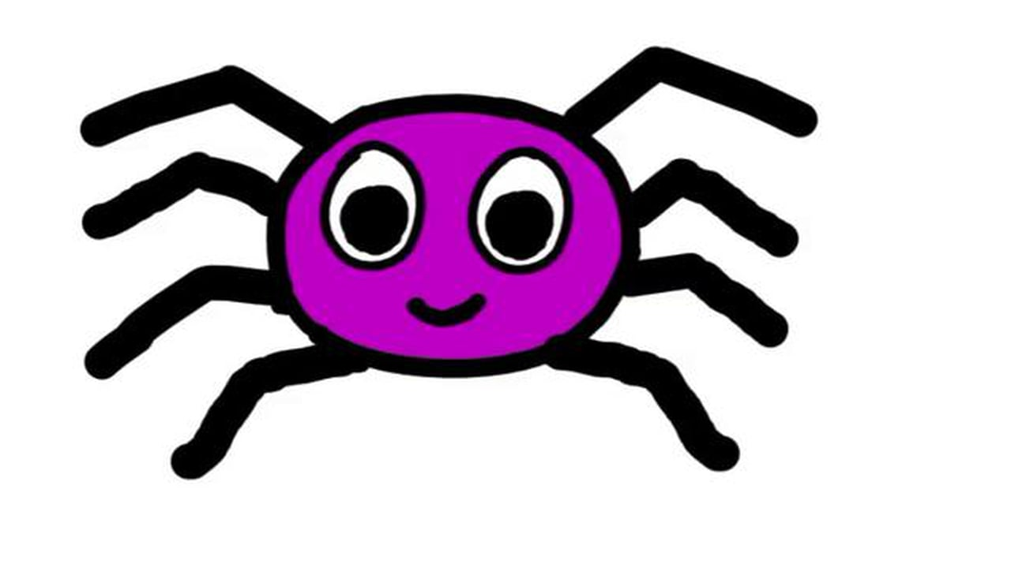
Incy Wincy Spider
Incy Wincy spider climbed up the water spout
Along came the rain and washed the spider out
Out came the sun and dried up all the rain
So Incy Wincy spider climbed up the spout again!

Slide 4
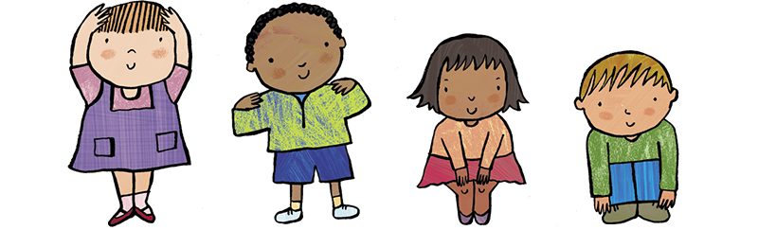
Head Shoulders Knees and Toes
Head, shoulders knees and toes, knees and toes
Head, shoulders knees and toes, knees and toes
And eyes and ears and mouth and nose
Head shoulders knees and toes, knees and toes!

Slide 5
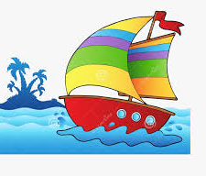
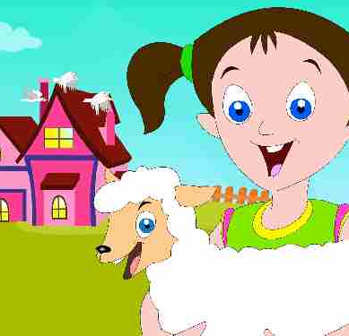
Merrily We Roll Along/Mary Had a Little Lamb
Merrily we roll along, roll along, roll along
Merrily we roll along o’er the big blue sea
Mary had a little lamb,
little lamb little lamb
Mary had a little lamb,
Its fleece was white as snow

Slide 6
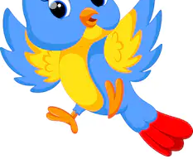

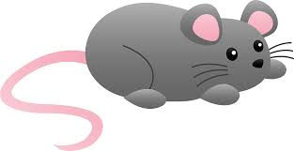
Hickory Dickory Dock
Hickory dickory dock, the mouse ran up the clock
The clock struck one, the mouse ran down, hickory dickory dock
Hickory dickory dock, the bird flew around the clock
The clock struck two, away the bird flew, hickory dickory dock
Hickory dickory dock, the monkey danced round the clock
The clock struck three, he climbed up a tree, hickory dickory dock
Hickory dickory dock, the big bear looked at the clock
The clock struck four, he walked through the door, hickory dickory dock
Hickory dickory dock, the bee buzzed around the clock
The clock struck five, she flew back to her hive, hickory dickory dock

Slide 7
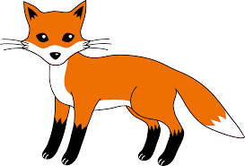

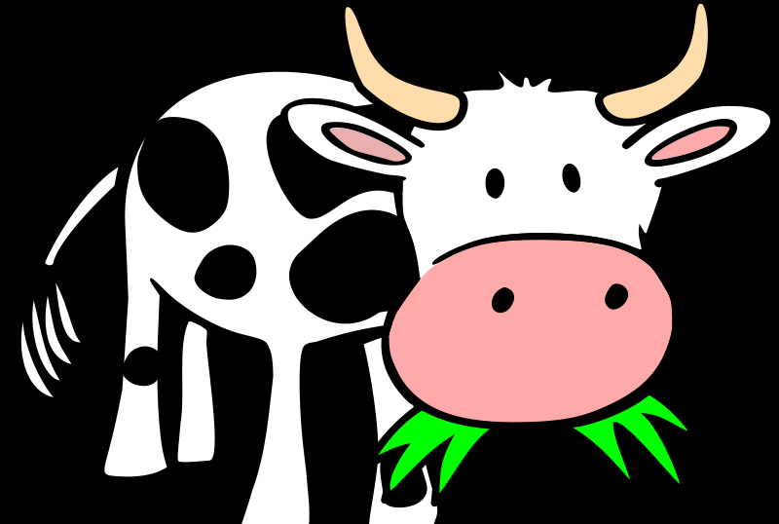
Hickory dickory dock, the fox danced around the clock
The clock struck six, she did some tricks, hickory dickory dock
Hickory dickory dock, a pig oinked at the clock
The clock struck seven, there is no eleven, hickory dickory dock
Hickory dickory dock, the cow mooed at the clock
The clock struck eight, she jumped over the gate, hickory dickory dock
Hickory dickory dock, a hen clucked at the clock
The clock struck nine, her chicks in line, hickory dickory dock
Hickory dickory dock, an elephant stamped on the clock
The clock struck ten, lets do it again, hickory dickory dock!

Slide 8

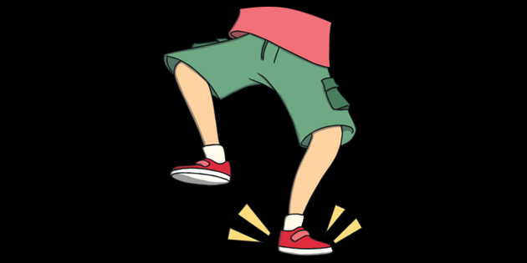
If you’re happy and you know it
If you’re happy and you know it clap your hands (clap clap)
If you’re happy and you know it clap your hands (clap clap)
If you’re happy and you know it and you really want to show it if you’re happy and you know it clap your hands (clap clap)
2. Stamp your feet (stamp stamp)
3. Honk your nose (honk honk)
4. Pat your head (pat pat)
5. Say “We Are!” (We Are!)

Slide 9

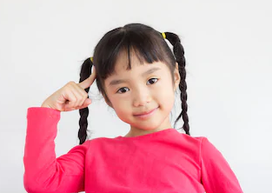
Put Your Finger on Your Head
Put your finger on your head on your head
Put your finger on your head on your head
Put your finger on your head, tell me is a green or red
Put your finger on your head, on your head
2.Put your finger on your ear – leave it there for a year
3.Put your finger on your cheek – leave it there for a week
4.Put your finger on your finger on your finger, etc

Slide 10
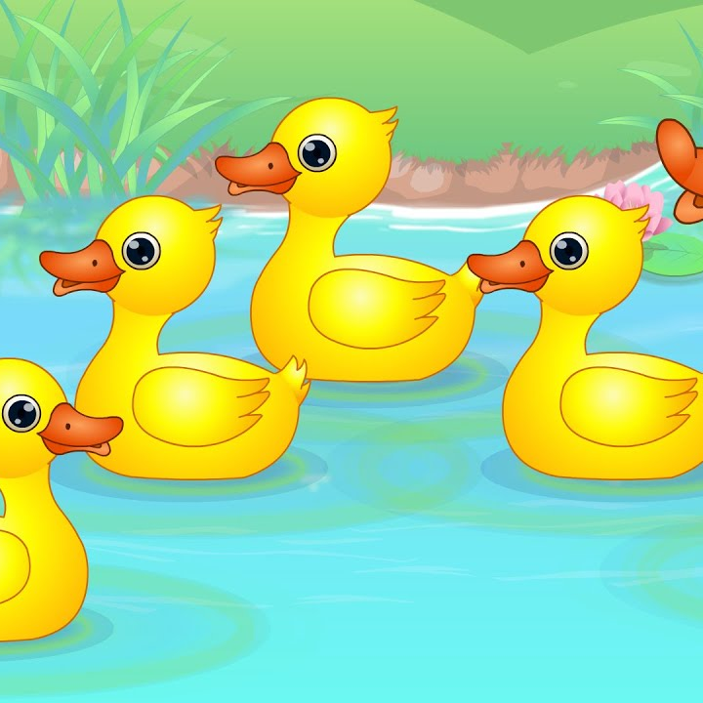
Five Little Ducks
Five little ducks went swimming one day, over the hills and far away
Mummy duck said “Quack quack quack quack” but only 4 little ducks came back.
2. Four little ducks went swimming one day . . . . But only 3 little ducks came back.
3. Three little ducks went swimming one day . . . . But only 2 little ducks came back.
4. Two little ducks went swimming one day . . . . But only 1 little duck came back
5. One little duck went swimming one day, over the hills and far away
Daddy duck said, “Quack quack quack quack!” and all the 5 little ducks came back!

Slide 11
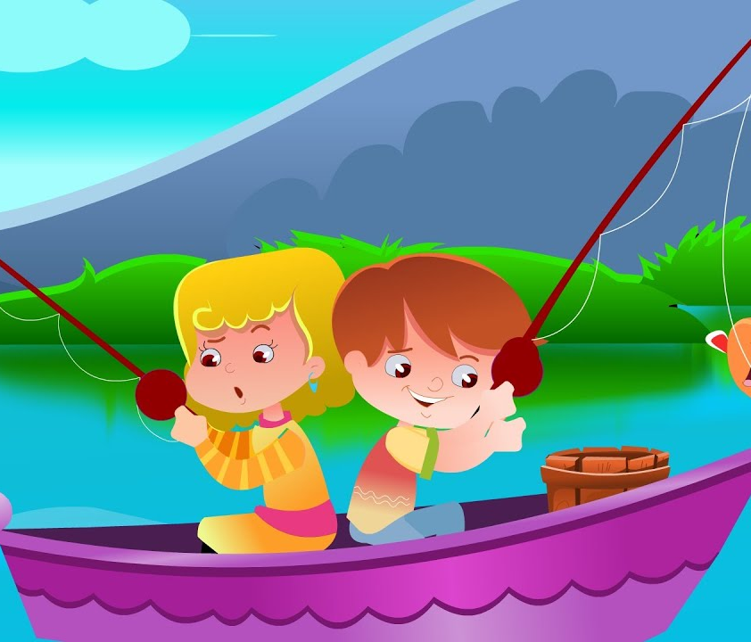
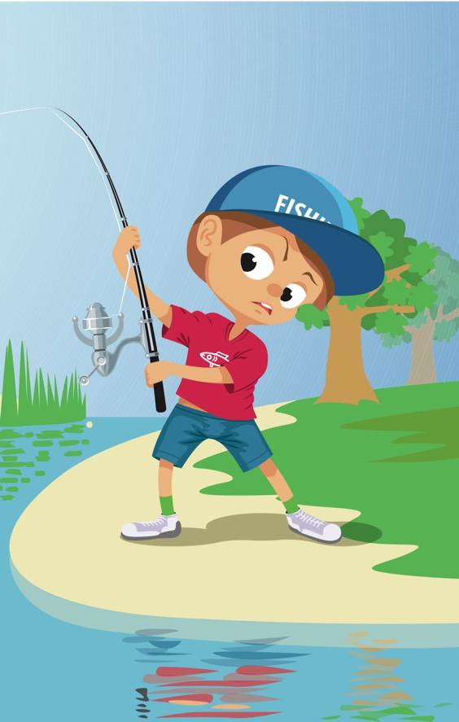
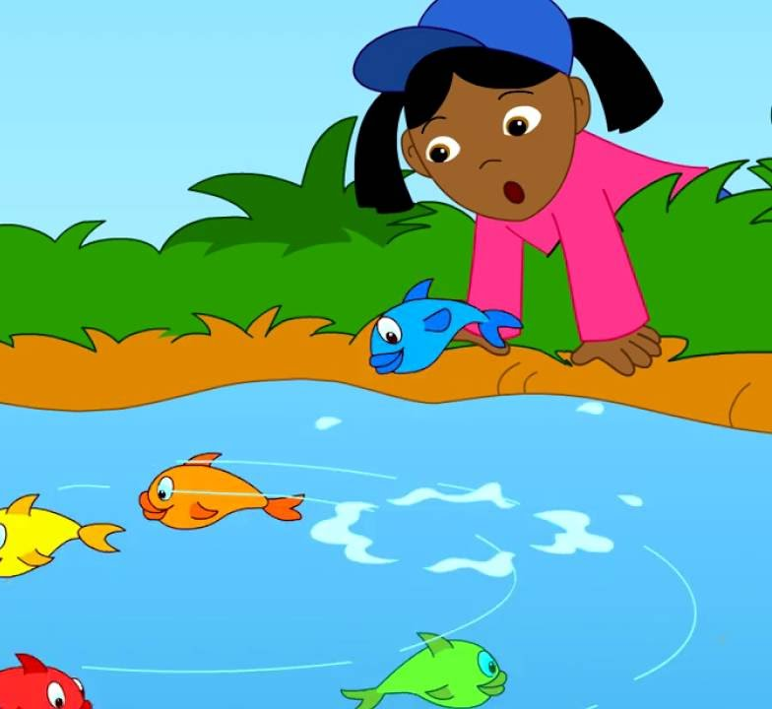
1 2 3 4 5 Once I Caught a Fish Alive
1 2 3 4 5 once I caught a fish alive,
6 7 8 9 10, then I let it go again.
Why did you let it go? Because it bit my finger so!
Which finger did it bite? This little finger on the right!

Slide 12
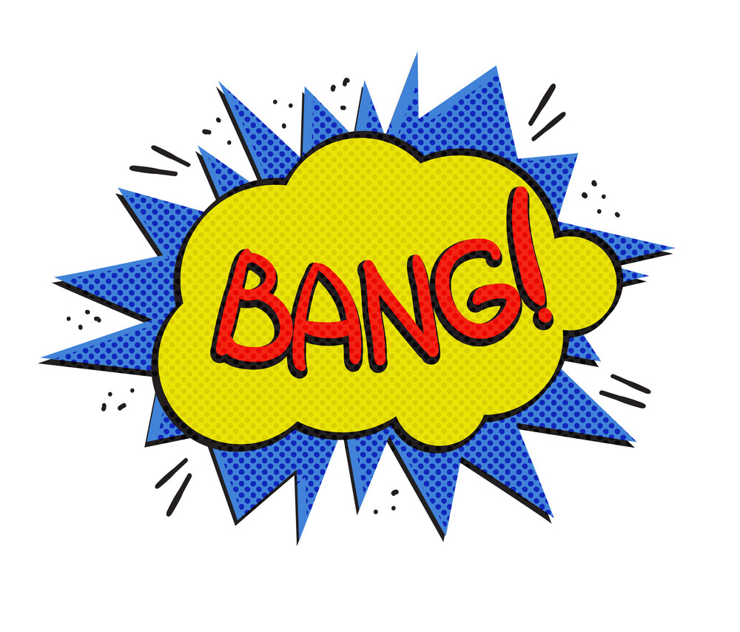
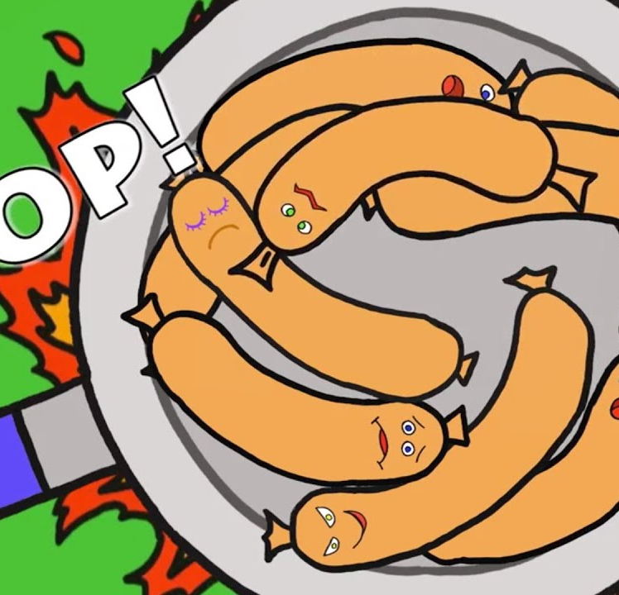
10 Fat Sausages
10 fat sausages sizzling in a pan, 10 fat sausages sizzling in the pan
One went POP! And one went BANG!
So now there’s 8 fat sausages sizzling in the pan!
8 fat sausages sizzling in the pan, 8 fat sausages sizzling in the pan
One went POP! And one went BANG!
So now there’s 6 fat sausages sizzling in the pan!
6 fat sausages sizzling in the pan, 6 fat sausages sizzling in the pan
One went POP! And one went BANG!
So now there’s 4 fat sausages sizzling in the pan!
4 fat sausages sizzling in the pan, 4 fat sausages sizzling in the pan
One went POP! And one went BANG!
So now there’s 2 fat sausages sizzling in the pan!
2 fat sausages sizzling in the pan, 2 fat sausages sizzling in the pan
One went POP! And one went BANG!
So now there’s NO fat sausages sizzling in the pan!

Slide 13
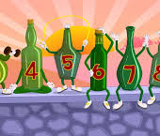
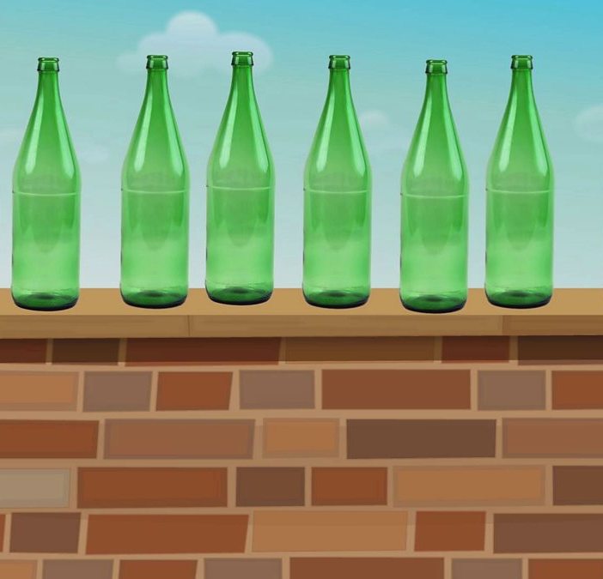
10 Green Bottles
10 green bottles sitting on the wall
10 green bottles sitting on the wall
But if one green bottle should accidently fall
There’ll be 9 green bottles sitting on the wall
Repeat with 9, 8, 7, 6, 5, 4, 3, 2, 1, 0.

Slide 14
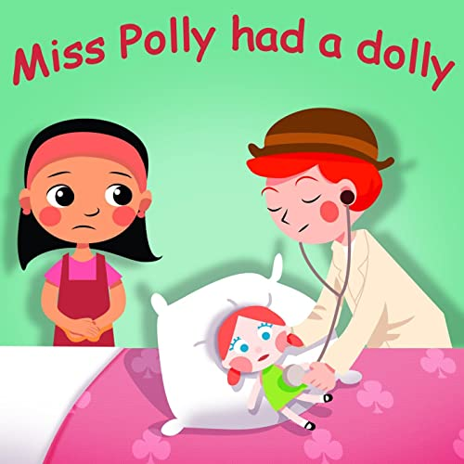
Miss Polly
Miss Polly had a dolly who was sick sick sick
So she phoned for the doctor to be quick quick quick
The doctor came with his bag and his hat and he knocked on the door with a rat-tat-tat-tat
He looked at the dolly and he shook his head
And he said “Miss Polly, but her straight to bed!”
He wrote on a paper for a pill pill pill
“I’ll be back in the morning with my bill bill bill!”

Slide 15

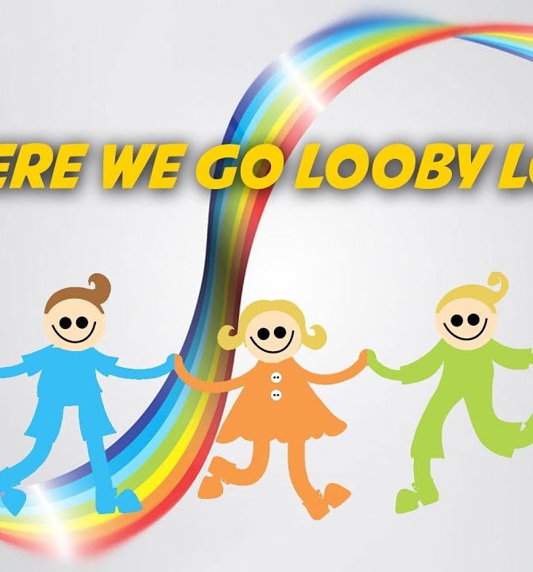
Here we go Looby Loo
Chorus: Here we go Looby Loo, here we go Looby light
Here we go Looby Loo, all on a Saturday night!
1. You put your right hand in, you take your right hand out
You give your hand a shake, shake, shake, And turn yourself about!
2. You put your left hand in, you take your left hand out
You give your hand a shake, shake, shake, And turn yourself about!
3. You put your right leg in, you take your right leg out
You give your leg a shake, shake, shake, And turn yourself about!
4. You put your left leg in, you take your left leg out
You give your leg and shake, shake, shake, And turn yourself about!
5. You put your wholeself in, you take your wholeself out
You give yourself a shake, shake, shake and turn yourself about!

Slide 16
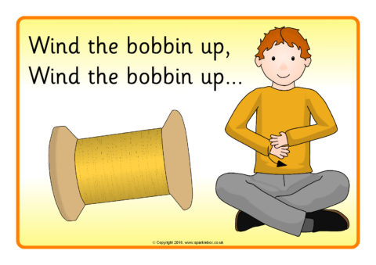
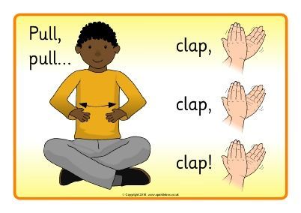
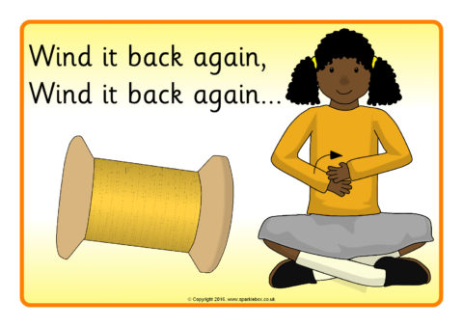
Wind the Bobbin Up
Wind the bobbin up, wind the bobbin up, pull, pull, clap, clap, clap
Wind it back again, wind it back again, pull, pull, clap, clap, clap.
Point to the ceiling, point to the floor,
Point to the window, point to the door.
Clap your hands together, 1, 2, 3, put your hands upon your knee
Wind the bobbin up, wind the bobbin up, pull, pull, clap, clap, clap.
Wind it back again, wind it back again, pull, pull, clap, clap, clap.

Slide 17
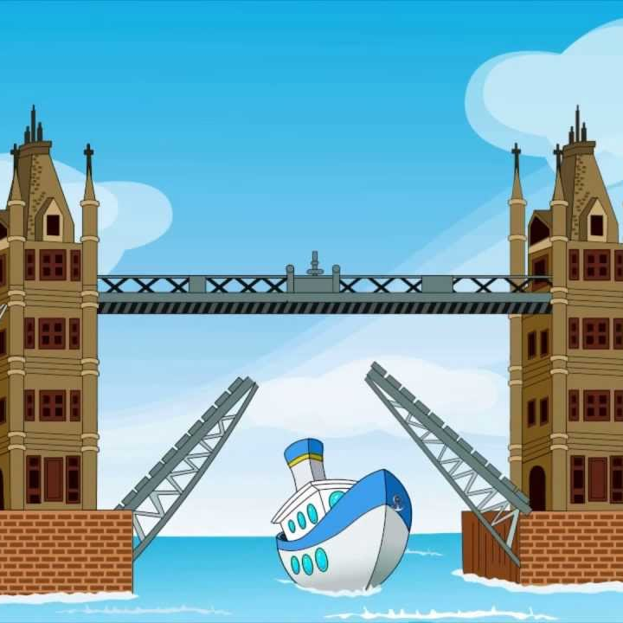
London Bridge is Falling Down
London Bridge is falling down, Falling down, falling down
London Bridge is falling down, My fair lady
Build it up with wood and clay, Wood and clay, wood and clay
Build it up with wood and clay, My fair lady
Wood and clay will wash away, Wash away, wash away
Wood and clay will wash away, My fair lady
Build it up with iron and steel, Iron and steel, iron and steel
Build it up with iron and steel, My fair lady
Iron and steel will bend and bow, Bend and bow, bend and bow
Iron and steel will bend and bow, My fair lady
London Bridge is falling down, Falling down, falling down
London Bridge is falling down, My fair lady

Slide 18
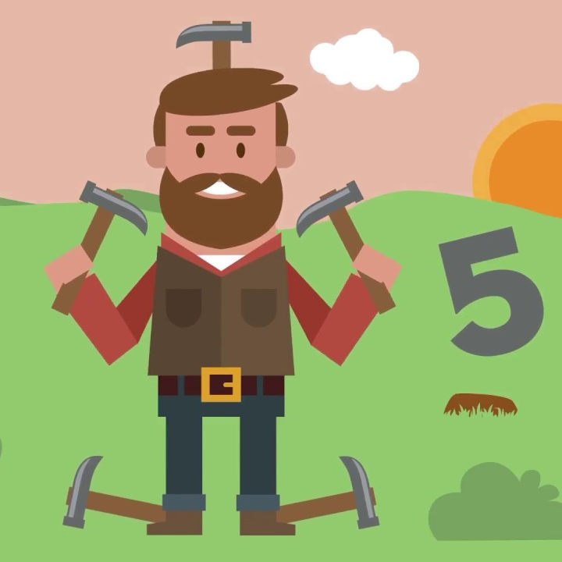
Johnny Taps with One Hammer
(one hand taps to the pulse) Johnny taps with one hammer, one hammer, one hammer
Johnny taps with one hammer, then he taps with two.
(both hands tap the pulse) Johnny taps with two hammers, two hammers, two hammers
Johnny taps with two hammers, then he taps with three.
(both hands and one foot) Johnny taps with three hammers, three hammers, three hammers
Johnny taps with three hammers, then he taps with four.
(both hands and both feet) Johnny taps with four hammers, four hammers, four hammers
Johnny taps with four hammers then he taps with five.
(both hands, both feet and nod head) Johnny taps with five hammers, five hammers, five hammers
Johnny taps with five hammers, then he goes on strike!

Slide 19
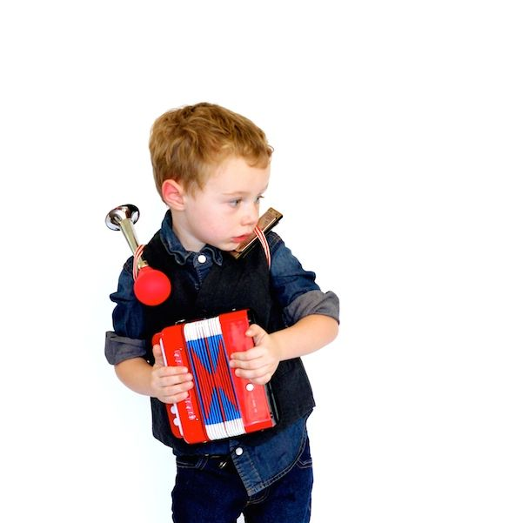
The Music Man
I am the music man, I come from down your way and I can play (what can you play?) I play piano.
Pia pia piano, piano, piano, pia pia piano, pia piano
I am the music man, I come from down your way and I can play (what can you play?) I play the trumpet.
Toot tee toot tee toot tee too, toot tee too, toot tee too, toot tee toot tee toot tee too, toot tee too tee too . . . Pia pia piano . . . .
I am the music man I come from down you way and I can play (what can you play?) I play the big drum.
Bom bom bom bom bom bom, toot tee toot tee, pia pia piano
I am the music man I come from down your way and I can play (what can you play?) I play the guitar.
Strum strum strum strum strum, bom bom bom, toot tee too tee, pia pia piano.
(Carry on adding other instruments to the same pattern)

Slide 20
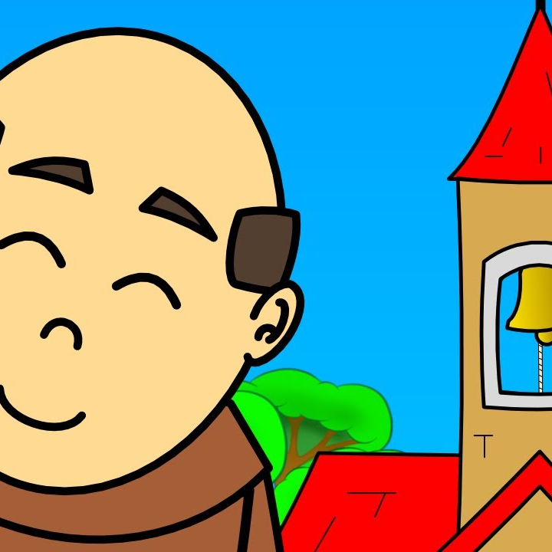
Frere Jacques
Frere Jacques, Frere Jacques
Dormez vous, dormez vous,
Sonnez les matines, sonnez les matines
Din din don! Din din don!
Are you sleeping? Are you sleeping?
Brother John, Brother John
Morning bells are ringing, morning bells are ringing
Ding Ding Dong! Ding Ding Dong!

Slide 21
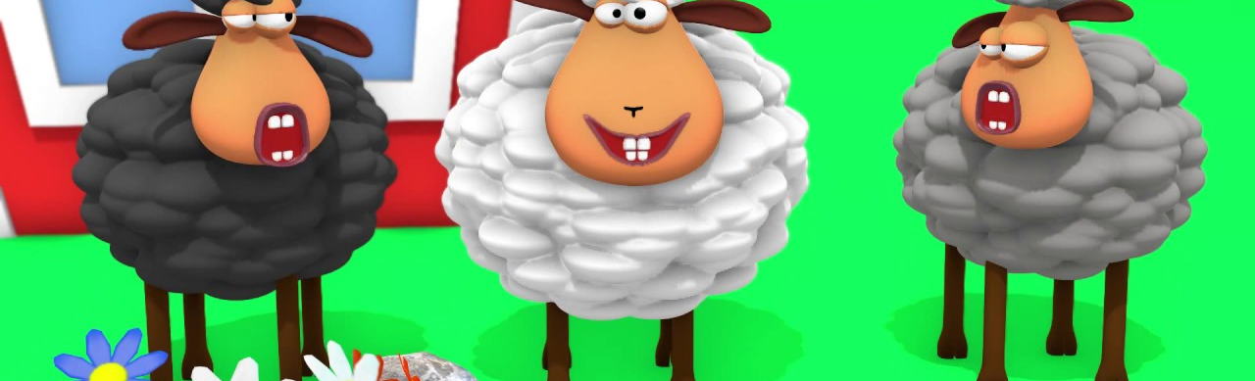
Baa Baa Black Sheep
Baa baa black sheep, have you any wool.
Yes sir, yes sir, three bags full.
One for the master and one for the dame
And one for the little boy who lives down the lane.

Slide 22
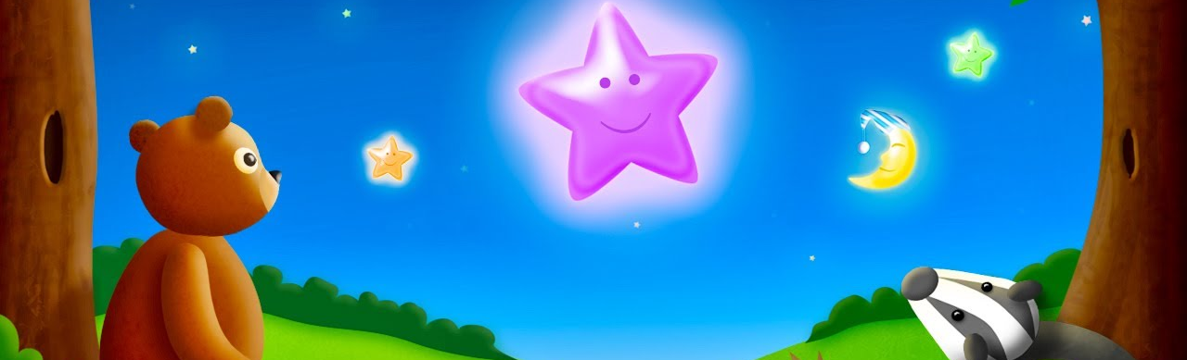
Twinkle Twinkle
Twinkle twinkle little star, how I wonder what you are
Up above the world so high, like a diamond in the sky
Twinkle twinkle little star, how I wonder what you are.

Slide 23
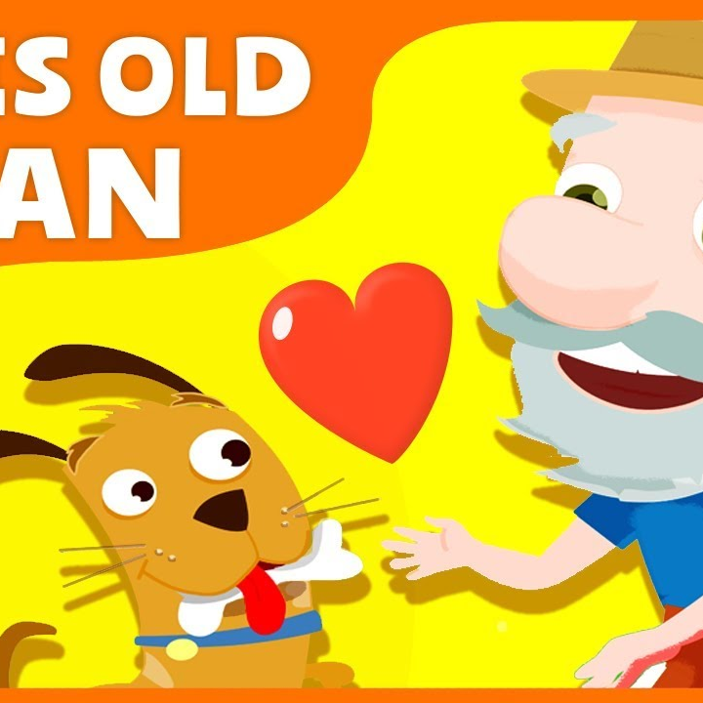
This Old Man
This old man, he played one, he played knick knack on my thumb,
With a knick knack paddy whack give the dog a bone,
This old man came rolling home.
This old man, he played two, he played knick knack on my shoe,
With a knick knack paddy whack give the dog a bone,
This old man came rolling home.
3. Played three on my knee 4. Played four on the floor
5. Played five on the hive 6. Played six on my sticks
7. Played seven up in heaven 8. Played eight on my gate
9. Played nine on my spine 10. Played ten once again

Slide 24
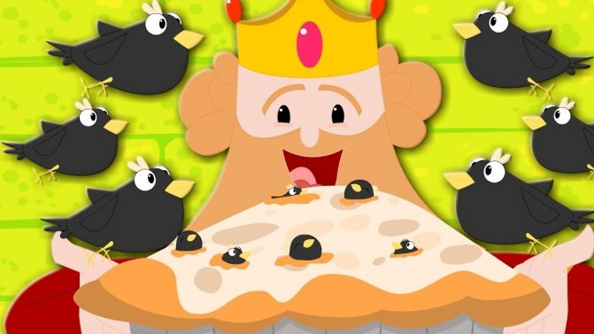
Sing a Song of Sixpence
Sing a song of sixpence a pocket full of rye
Four and twenty black birds baked in a pie
When the pie was opened the birds began to sing
Wasn’t that a dainty dish to set before the king.
The king was in his counting house, counting out his money
The queen was in the parlour, eating bread and honey
The maid was in the garden hanging out her clothes
When up came a blackbird and pecked off her nose.

